Slide 1
بسم اله الرحمن الرحیم

Slide 2
Fluid and Electrolyte
Dr soltanain
anesthesiologist

Slide 3
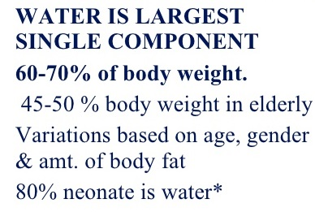

Slide 4
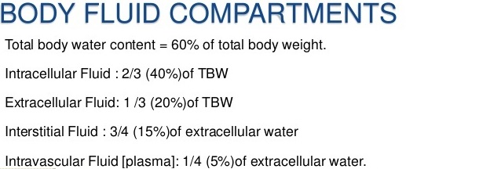

Slide 5
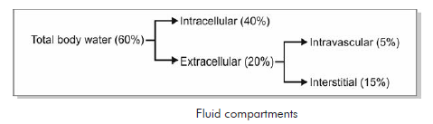

Slide 6
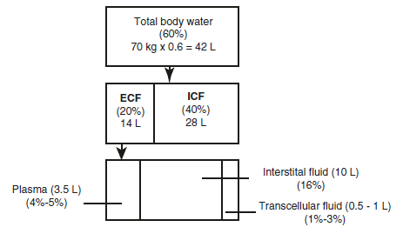

Slide 7
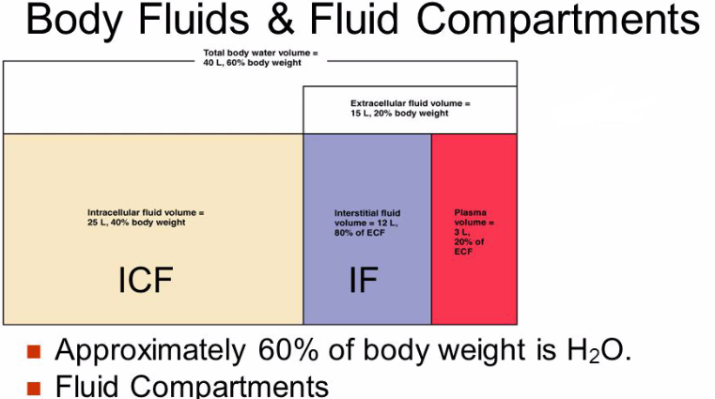

Slide 8
ELECTROLYTES
Cations : positive charge
Anions : negative charge
Cations : sodium, potassium , magnesium and hydrogen ions and …
Anions : chloride , Bicarbonate, Sulfate, Phosphate and …

Slide 9
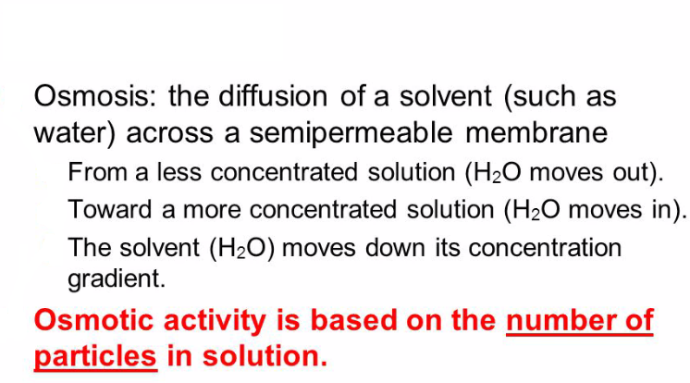

Slide 10
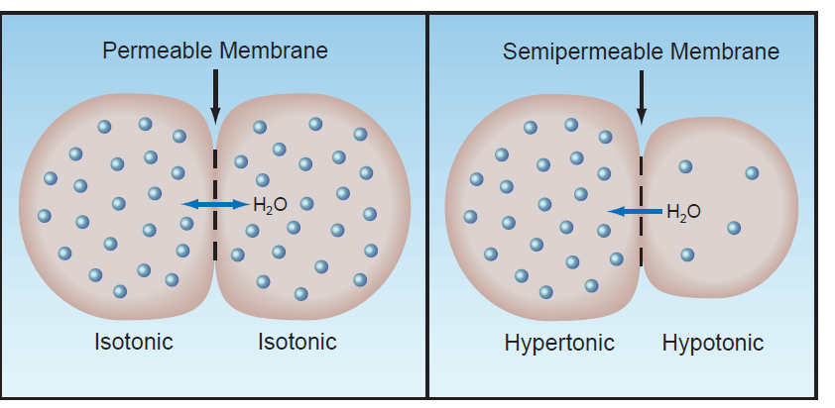

Slide 11
osmolality: number of moles of a chemical compound that contributes to the solutions osmotic pressure and is expressed as mosm/kg of water.
Plasma osmolality: determined largely by sodium salt.
Normal plasma osmolality: 275-295 mosm/kg

Slide 12
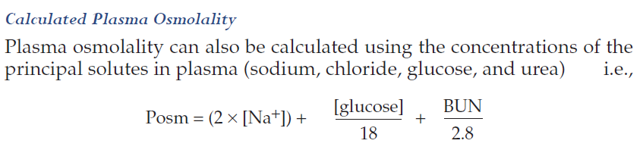

Slide 13
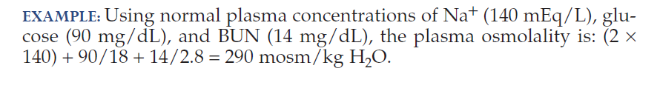

Slide 14
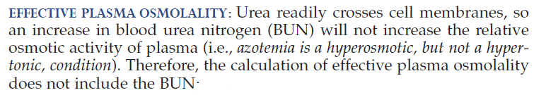

Slide 15


Slide 16
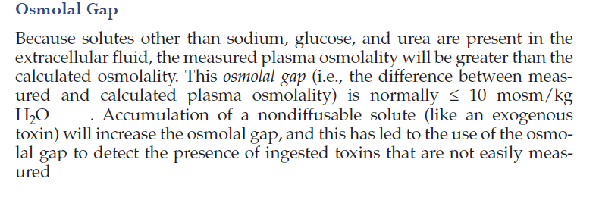

Slide 17
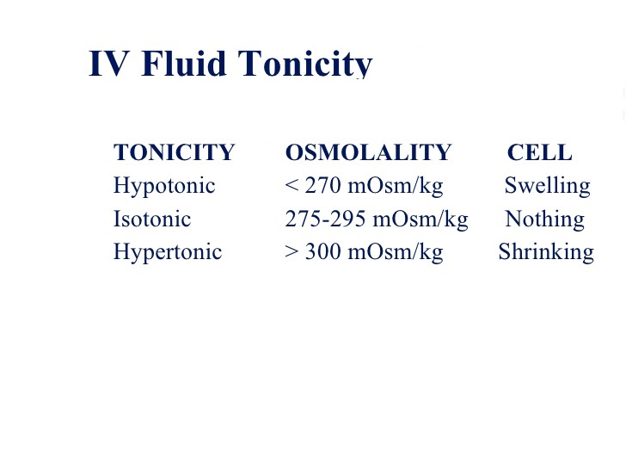

Slide 18
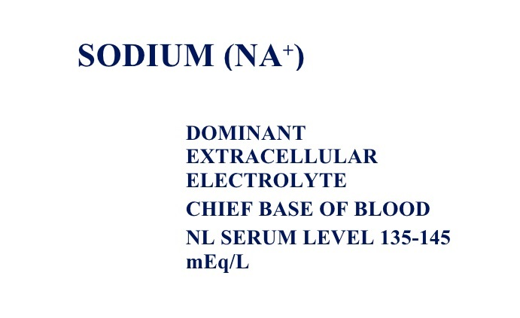

Slide 19
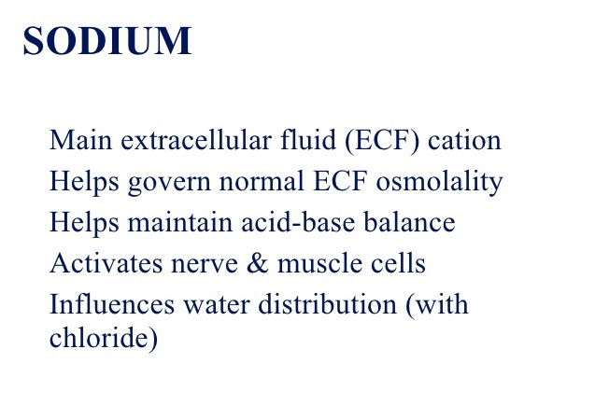

Slide 20
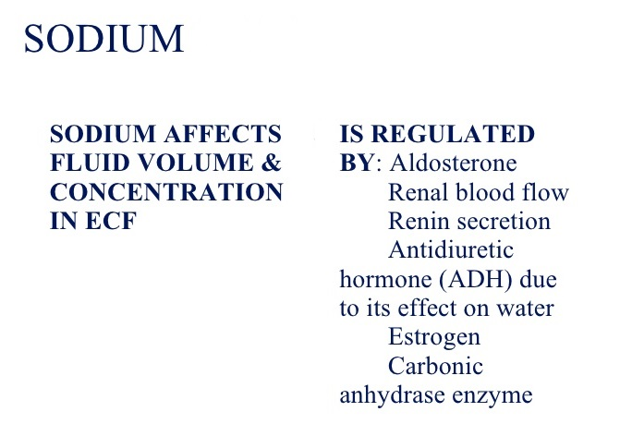

Slide 21
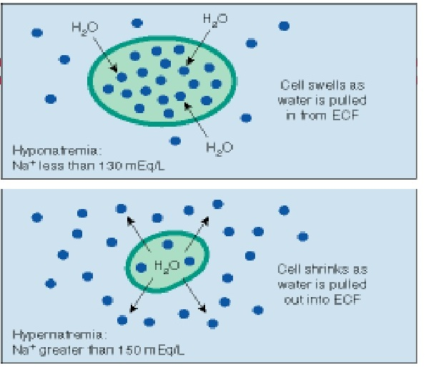

Slide 22
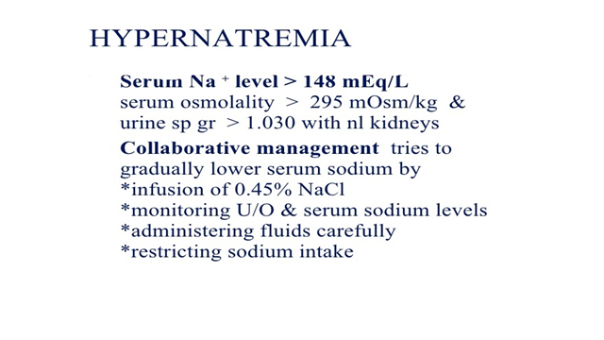

Slide 23
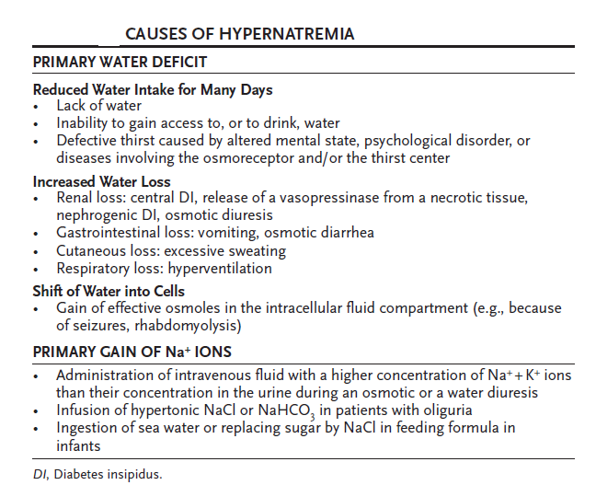

Slide 24
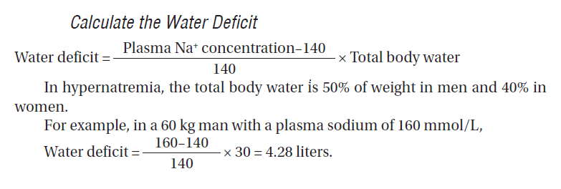

Slide 25
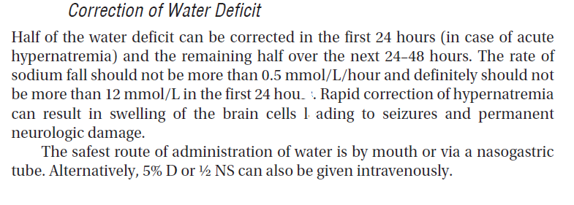

Slide 26


Slide 27
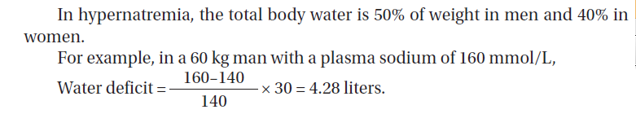

Slide 28


Slide 30
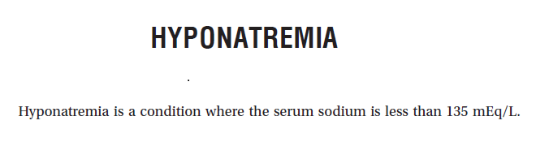

Slide 31
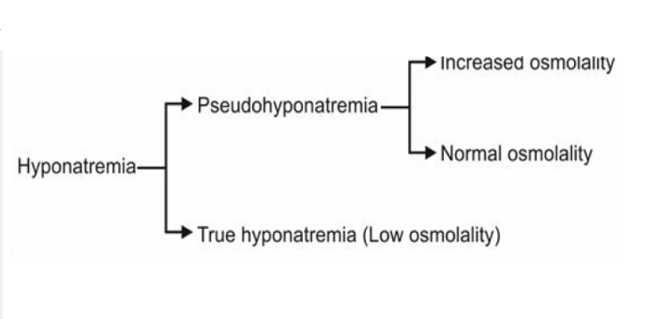

Slide 32
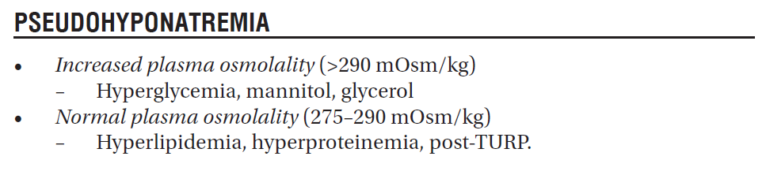

Slide 33
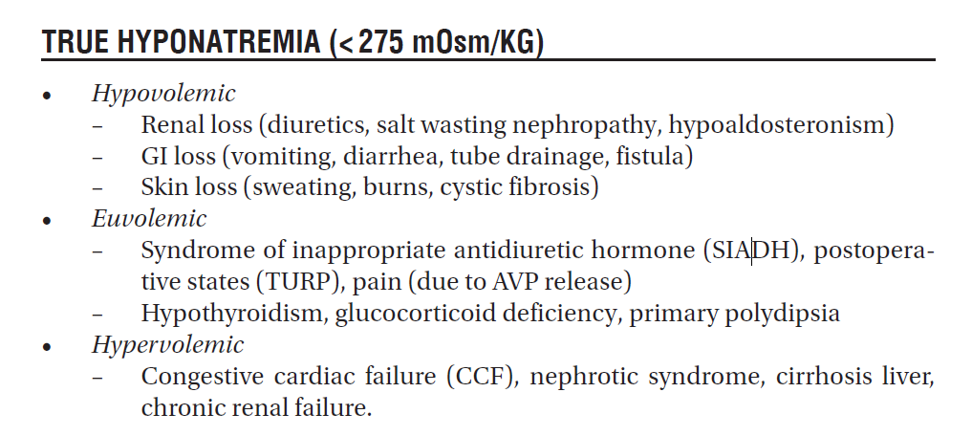

Slide 34
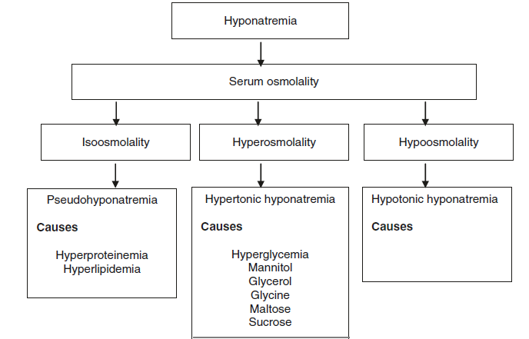

Slide 35
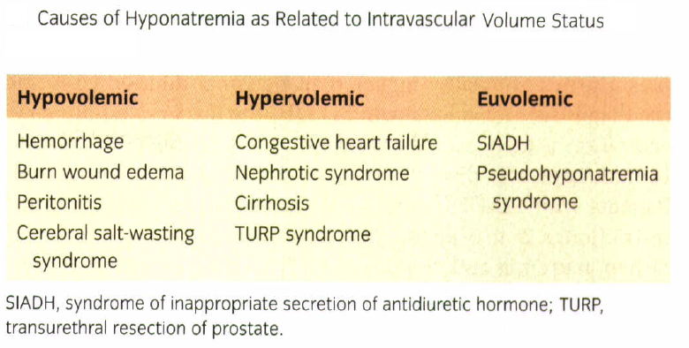

Slide 36
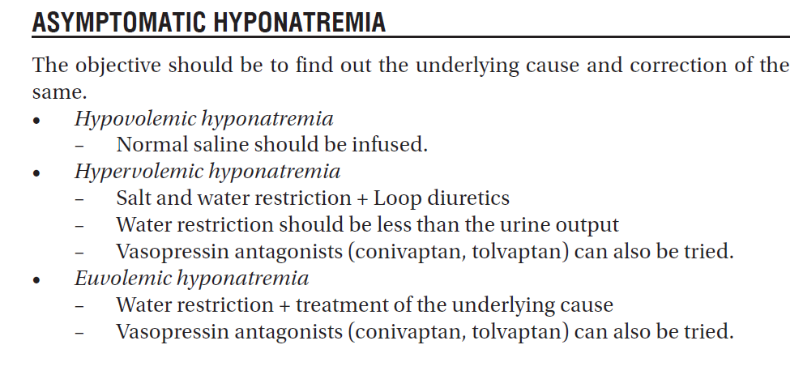

Slide 37
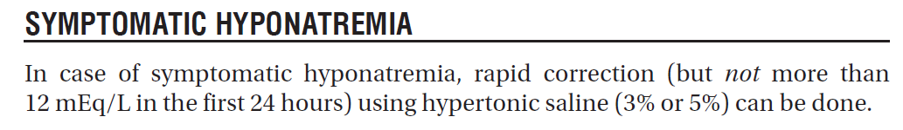

Slide 38
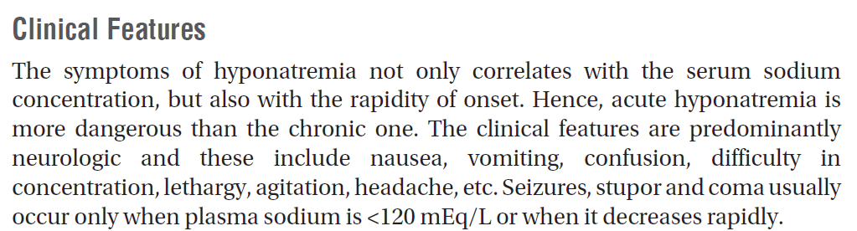

Slide 39
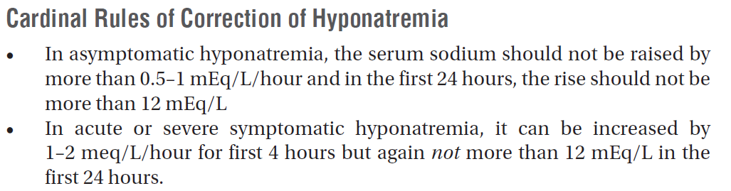

Slide 40
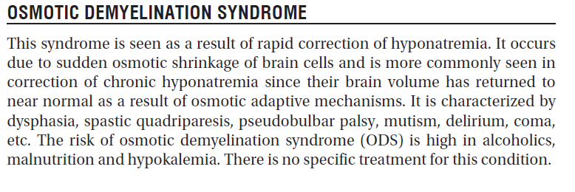

Slide 41
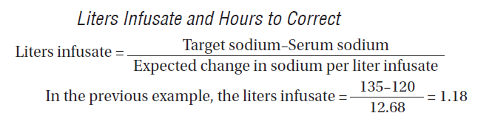

Slide 42
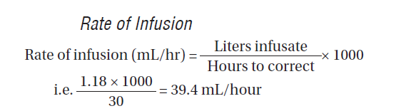

Slide 44
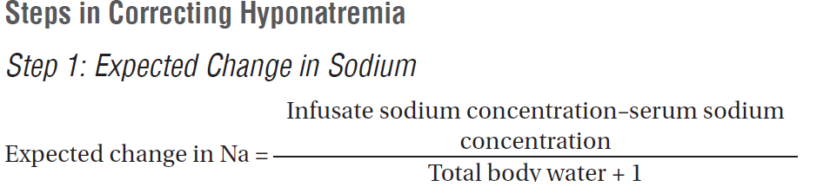

Slide 45
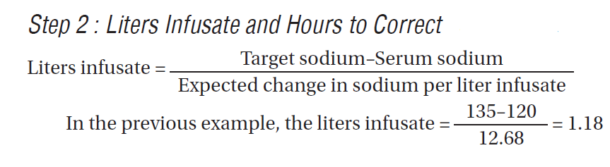

Slide 46
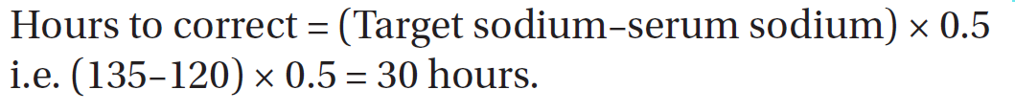

Slide 47
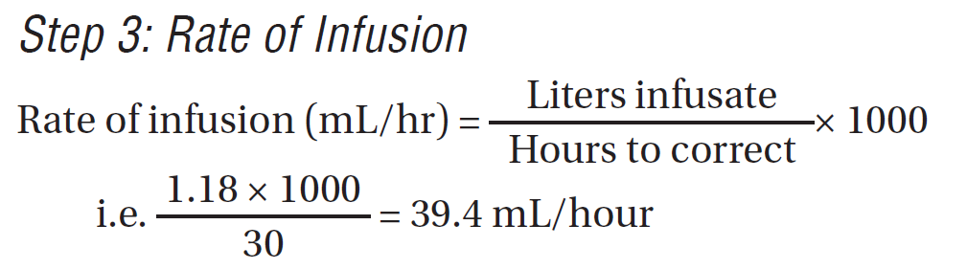

Slide 48


Slide 49
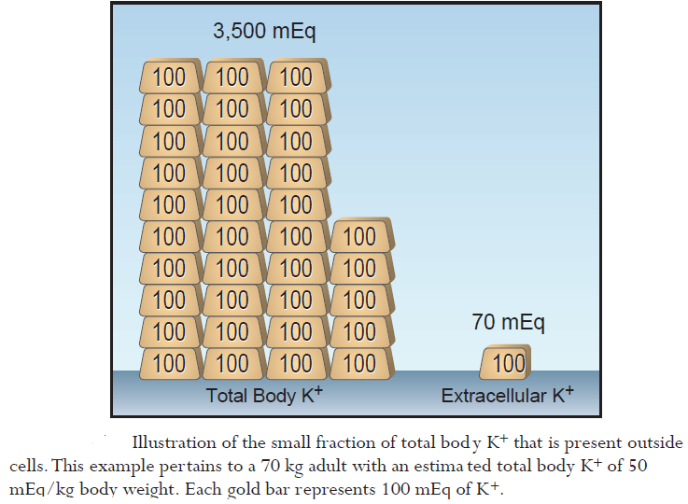

Slide 50
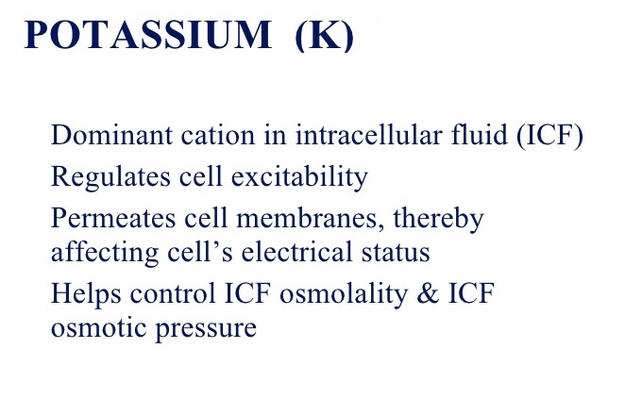

Slide 51
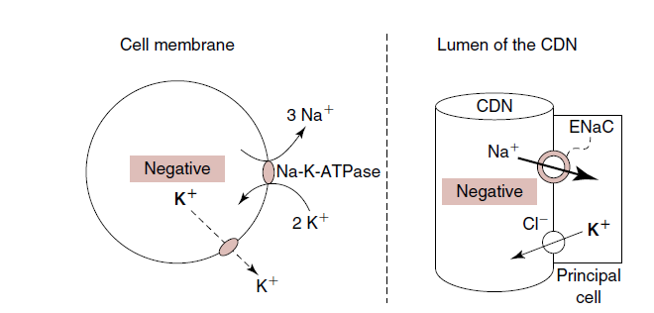

Slide 52
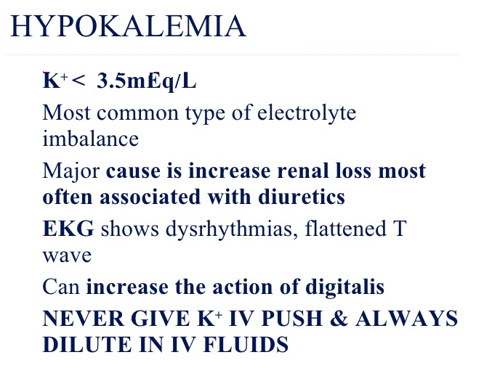

Slide 53
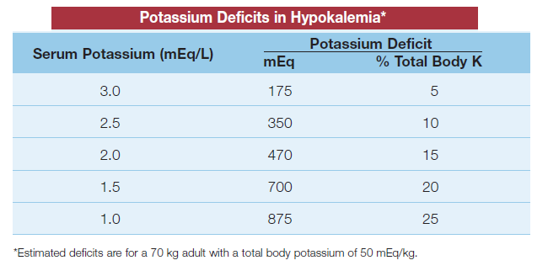

Slide 54
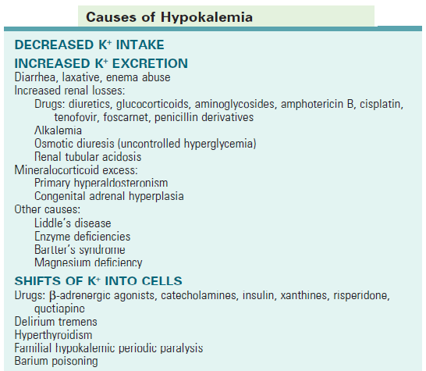

Slide 55
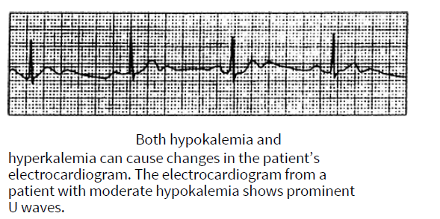

Slide 56
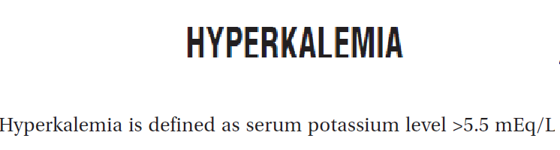

Slide 57
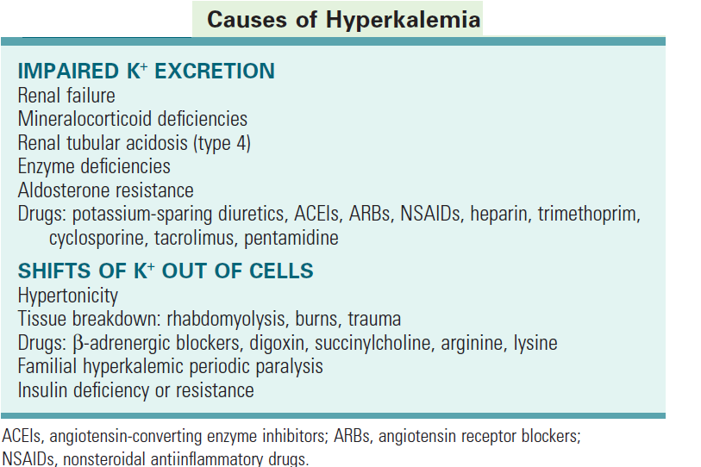

Slide 58
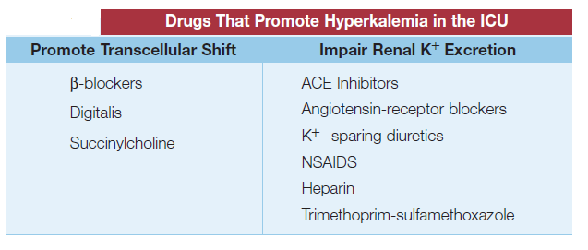

Slide 59
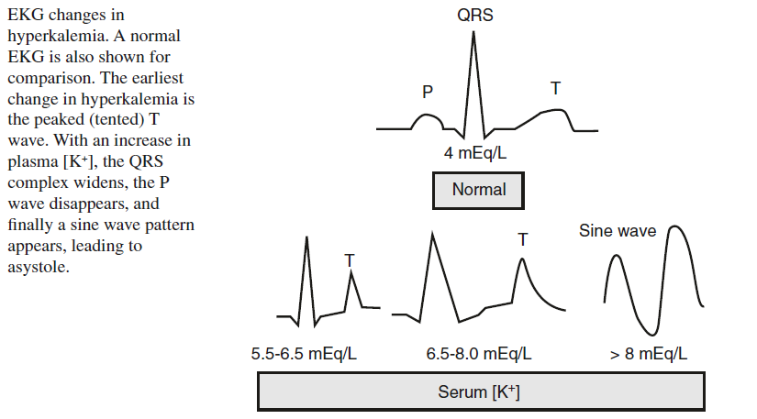

Slide 60
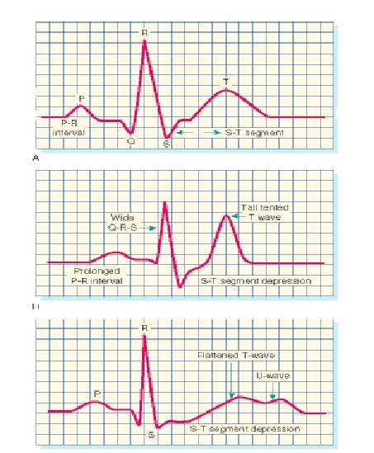

Slide 61


Slide 62


Slide 63


Slide 64


Slide 65


Slide 66


Slide 67


Slide 68


Slide 70


Slide 71


Slide 72


Slide 73


Slide 74


Slide 75


Slide 76
Intravenous Fluids: Composition and Indications

Slide 77


Slide 78


Slide 79


Slide 80


Slide 81


Slide 82


Slide 83


Slide 84


Slide 86


Slide 87


Slide 88


Slide 89


Slide 90


Slide 91


Slide 92
REFRENCES:
1.prem kumar et a l: ICU manual, 2017
2. Richard S. Irwin, Craig M. Lilly et al : intensive care medicine , eighth edition 2018
3. Paul L. Marino :The ICU book, 2014
4. Ronald D. Miller, Neal H. Cohen, et al: Miller’s Anesthesia, EIGHTH EDITION,2015

Slide 93
THE END

